Slide 1
Design Methodologies & Implementation Technologies
EE417 Logic Design Using FPGAs

Slide 2

The DESIGN Process
Specifications
or Design Idea
Preliminary Design
High-level (behavioral) Simulation
Functional Description
Detailed Design
Schematic/HDL capture Logic simulation
Timing Analysis
Detailed Description
Implementation
Optimization and Verification
Simulation
Logic synthesis
Optimization
Manufacturing
Testing
Boundary-scan
Built-in testing

Slide 3
Implementation Technologies
Digital Logic
Standard Logic
Programmable Logic Devices
ASIC
Full Custom
PLDs
CPLDs
FPGAs
Microprocessor & RAM
TTL 74xx
CMOS
4xxx
Gate Arrays
Standard
cells

Slide 4
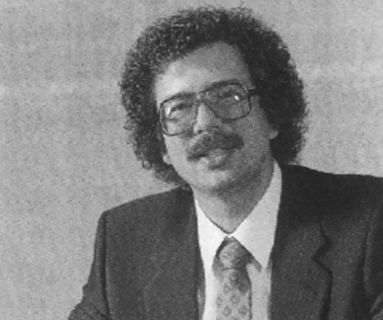
Ross Freeman (1948-1989)
Freeman co-founded Xilinx in 1984, and a year later in 1985 invented the first Field Programmable Gate Array. Freeman died in 1989 of pneumonia, only a few years after creating a new industry with the FPGA and launching what would become a multi-billion dollar company.

Slide 5
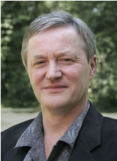
Phil Moorby (1953-2022)
In 1984 he invented the Verilog HDL, and developed the industry standard simulator Verilog-XL, and became a Cadence Fellow in 1990. In 1999 he joined Co-Design Automation where the Superlog HDL was developed that became the basis of the SystemVerilog effort. In 2002 he became a Synopsys Scientist and was working on several aspects of the SystemVerilog verification language and its implementation.

Slide 6
Levels of Design Abstraction
Design Levels | Design Description | Primitive Components | Theoretical Techniques
Algorithmic | Specifications High-level Language Math Equations | Functional Blocks (black boxes) | Signal processing theory Control Theory Sorting Algorithm
Functional | VHDL, Verilog | Registers Counters ALU | Abstract autonomous machines Timing Analysis
Logic | Boolean equations Truth Tables Timing Diagrams | Logic Gates Flip-Flops | Boolean Algebra K-map Boolean minimization
Circuit | Circuit equations Transistor netlist | Transistors Passive components | Linear/non-linear equations Fourier Analysis

Slide 7
Design Description
Schematic Capture | Hardware Description Languages
Good for multiple data flow Gives an overview picture Relates to hardware better High information density Back annotations possible (for delay tracking) | Flexible & Parametrizable Excellent for Optimization & Synthesis Direct mapping to algorithm Excellent for DataPath Readily interfaced for optimizers Easy to handle and transmit electronically
Not good for algorithms Not good for DataPath Does not interface well for optimizers Not good for synthesis software Difficult to reuse Not parametrizable | Essentially serial representation May not show the overall circuit picture Often needs good programming skills Does not show the physical hardware Needs special software

Slide 8
The Design Process
Top-down Design
Refine Specifications successively
Decompose each component into small components
lowest-level primitive components
Bottom-up Design Strategies
Build-up from primitive components
Combined to form more complex components
Mixed Strategies
Mostly top-down but with some bottom-up design flow

Slide 9
Design Tools
Modern digital design systems contain most of the following features:
Schematic Capture
Hardware description language
Logic synthesis and optimization
Timing analysis
Parametrized library components
Hierarchical Design management
Simulation with Timing
Auto-placement and routing
Floorplan editing
Reporting

